Slide 1
Notes:
Fold Up Paper #2 Front
Print Double Sided on Short Edge

Slide 2
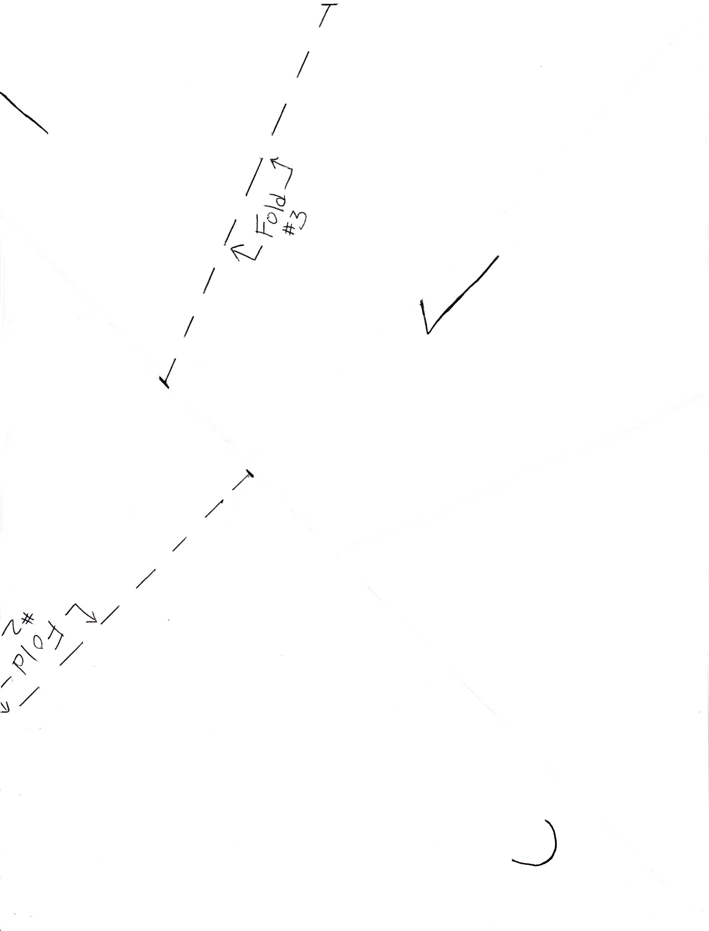
Notes:
Fold Up Paper #2 Front
Print Double Sided on Short Edge

Slide 3
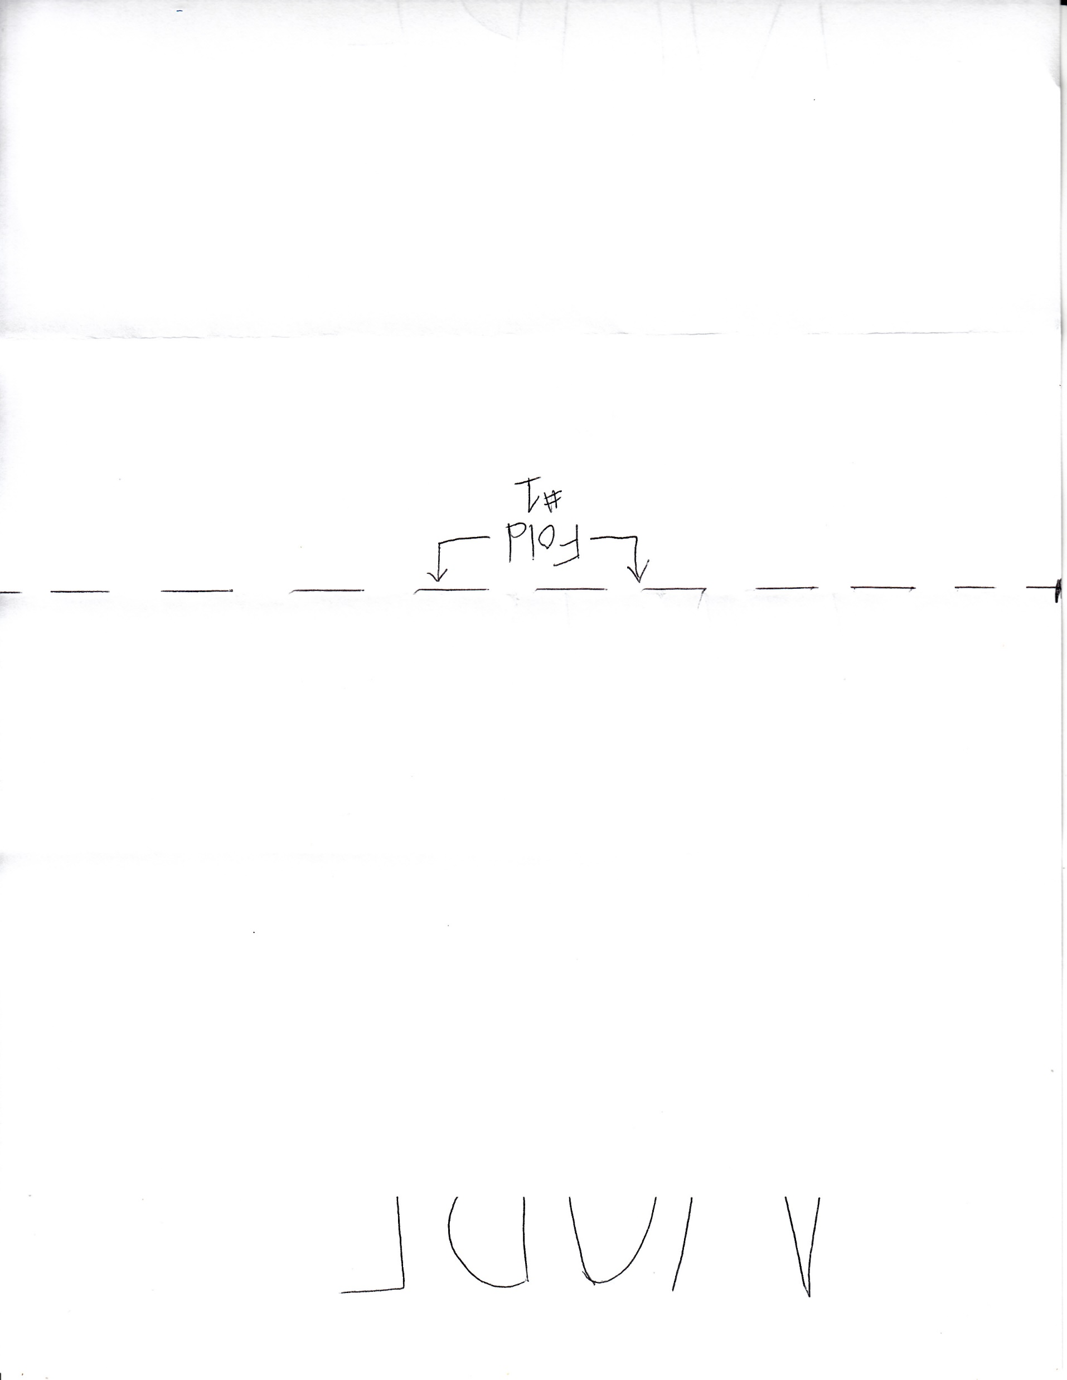

Slide 4
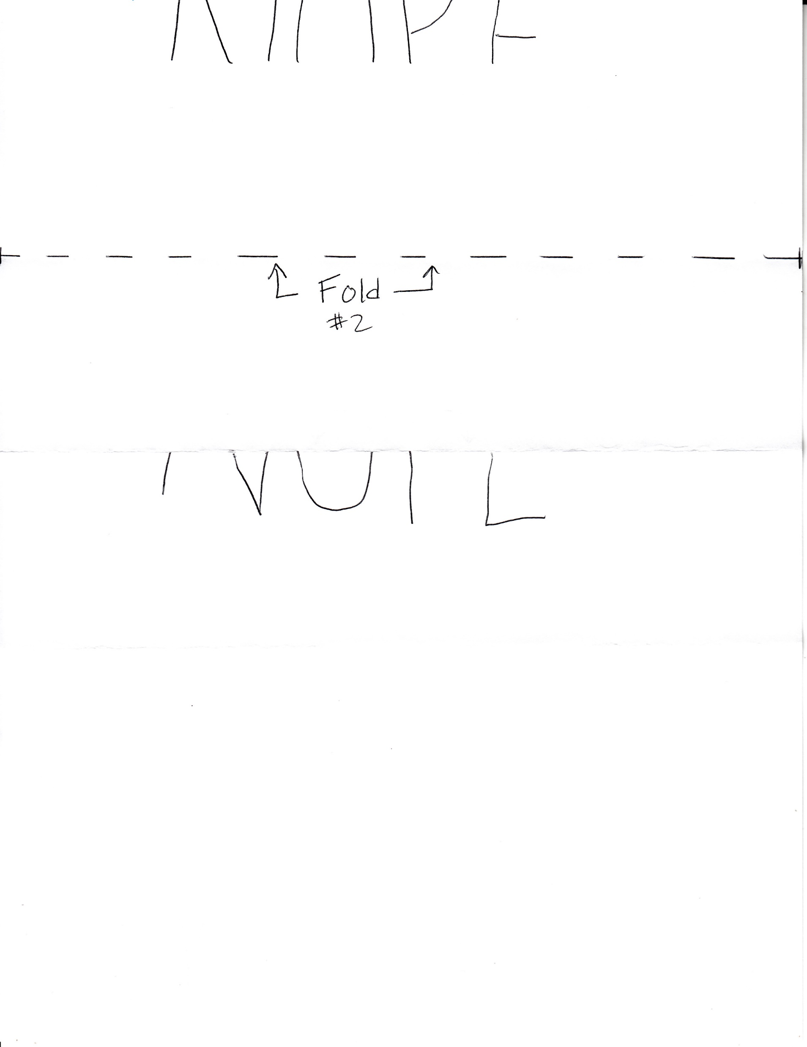

Slide 5
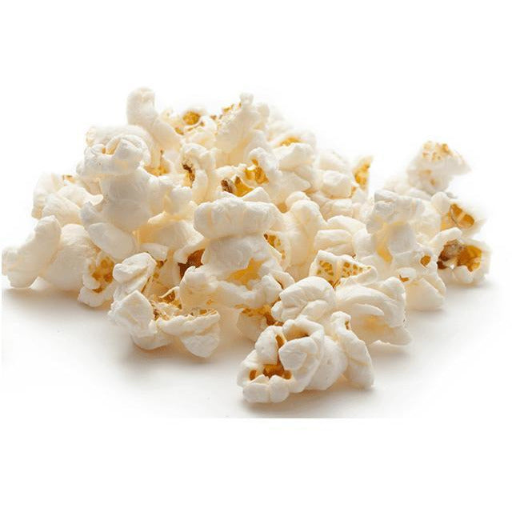
Notes:
Reversible or Irreversible Changes – Match Up
One image is taped to an envelope. Inside the envelope are the papers to fold that give a clue (“Nope” or “2”).
What change is not like the other? Melting ice cube to puddle is reversible (this gets the “2” clue). The corn, fire and bread are irreversible (this gets the “Nope” clue).

Slide 6
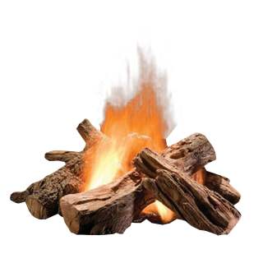
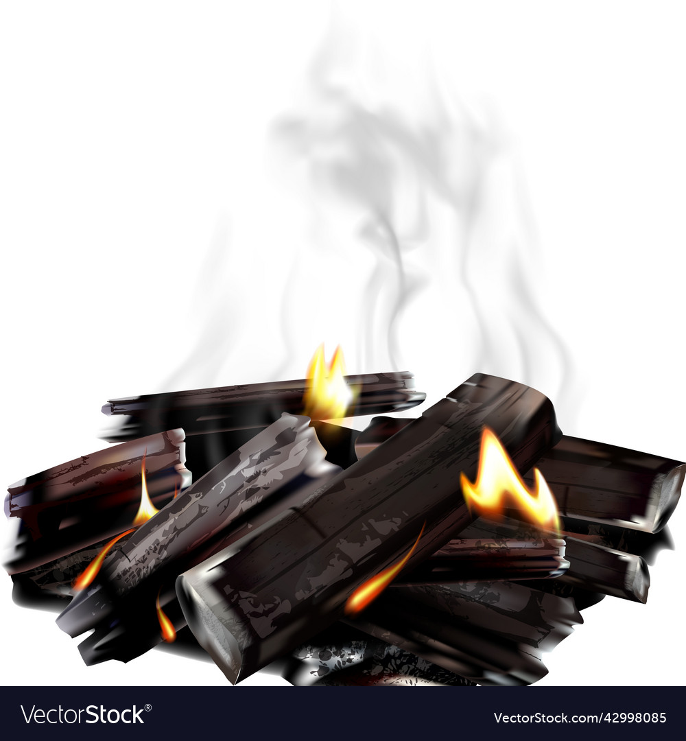
Notes:
Reversible or Irreversible Changes – Match Up
One image is taped to an envelope. Inside the envelope are the papers to fold that give a clue (“Nope” or “2”).
What change is not like the other? Melting ice cube to puddle is reversible (this gets the “2” clue). The corn, fire and bread are irreversible (this gets the “Nope” clue).

Slide 7
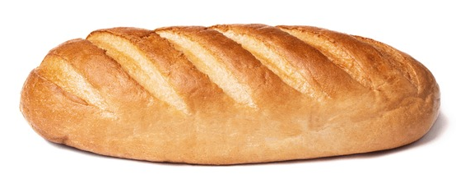
Notes:
Reversible or Irreversible Changes – Match Up
One image is taped to an envelope. Inside the envelope are the papers to fold that give a clue (“Nope” or “2”).
What change is not like the other? Melting ice cube to puddle is reversible (this gets the “2” clue). The corn, fire and bread are irreversible (this gets the “Nope” clue).

Slide 8
Notes:
Reversible or Irreversible Changes – Match Up
One image is taped to an envelope. Inside the envelope are the papers to fold that give a clue (“Nope” or “2”).
What change is not like the other? Melting ice cube to puddle is reversible (this gets the “2” clue). The corn, fire and bread are irreversible (this gets the “Nope” clue).

Slide 9
Match up the changes.
Which change is not like the others?
Open that envelope.
Take out one piece of paper.
Fold the paper (follow instructions).
Reveal the clue.
Match up the changes.
Which change is not like the others?
Open that envelope.
Take out one piece of paper.
Fold the paper (follow instructions).
Reveal the clue.
Reversible or Irreversible
Changes
Reversible or Irreversible
Changes
Notes:
Directions for Reversible or Irreversible Changes Activity

Slide 10
SEVEN
SEVEN
SEVEN
SEVEN
SEVEN
SEVEN
SEVEN
SEVEN
Notes:
Properties of Matter Maze: Flexibility: Is it flexible? (Does the item bend?) Hardness: Is it hard or firm? (Does it flake or scratch?) Using the penny, scrape the surface of each item. Texture: Is it smooth or rough? How does it feel?

Slide 11
Properties of Matter Maze
 | Flexible Does it bend? | Hardness Does it flake? | Texture Is it smooth?
rock
plastic lid
wood stick
paper
Start
End
Notes:
Properties of Matter Maze: Flexibility: Is it flexible? (Does the item bend?) Hardness: Is it hard or firm? (Does it flake or scratch?) Using the penny, scrape the surface of each item. Texture: Is it smooth or rough? How does it feel?

Slide 12
Complete the Maze. Test each item you pass for:
Flexibility. Is it flexible? Does it bend easily?
Hardness. How hard is it? Take a penny and scrape each item. Does the penny leave scratch marks? Do pieces flake off?
Texture. Does it feel smooth or rough?
Write your thoughts in the chart.
See any clues?
Complete the Maze. Test each item you pass for:
Flexibility. Is it flexible? Does it bend easily?
Hardness. How hard is it? Take a penny and scrape each item. Does the penny leave scratch marks? Do pieces flake off?
Texture. Does it feel smooth or rough?
Write your thoughts in the chart.
See any clues?
Properties of Matter Maze
Properties of Matter Maze
Notes:
Properties of Matter Maze: Flexibility: Is it flexible? (Does the item bend?) Hardness: Is it hard or firm? (Does it flake or scratch?) Using the penny, scrape the surface of each item. Texture: Is it smooth or rough? How does it feel?

Slide 13
Did it soak up water?
Did it soak up water?
Unscramble the Words
Unscramble the Words
flio
rppea
flio
rppea
rebrub
rebrub
eopsgn
eopsgn
Notes:
Absorbency

Slide 14
1. Fill the cup with some water (about half way).
2. Using a pipette, soak up some water from the cup.
3. Squeeze a few drops of water onto each item:
aluminum foil, sponge, paper, rubber eraser
What absorbs the water? What does not?
4. Unscramble the words and complete the chart.
See any clues?
1. Fill the cup with some water (about half way).
2. Using a pipette, soak up some water from the cup.
3. Squeeze a few drops of water onto each item:
aluminum foil, sponge, paper, rubber eraser
What absorbs the water? What does not?
4. Unscramble the words and complete the chart.
See any clues?
Absorbency
Absorbency
Notes:
Absorbency

Slide 15
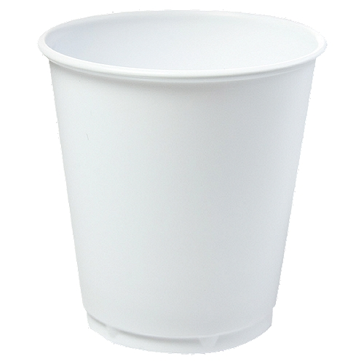
Solve the Problem
Solve the Problem
Fill
A
B
Clue
Fill
A
B
Clue
Notes:
Shape Shifting Liquid

Slide 16
Fill the water bottle to the line.
Pour the water into container “A”. How high is the water? Write the number on the worksheet.
Pour the water from container “A” to container “B”. How high is the water? Write the number on the worksheet.
Solve the problem to find the clue.
Fill the water bottle to the line.
Pour the water into container “A”. How high is the water? Write the number on the worksheet.
Pour the water from container “A” to container “B”. How high is the water? Write the number on the worksheet.
Solve the problem to find the clue.
Fill the water bottle to the line.
Pour the water into container “A”. How high is the water? Write the number on the worksheet.
Pour the water from container “A” to container “B”. How high is the water? Write the number on the worksheet.
Solve the problem to find the clue.
Shape Shifting Liquid
Shape Shifting Liquid
Shape Shifting Liquid
Notes:
Shape Shifting Liquid

Slide 17
Greetings Students,
Greetings Students,
You are tasked to solve this matter mystery! To discover what’s in the box:
Complete each activity to reveal a clue
Write the clues in the correct boxes below
Then use the code to unlock your box
What will you find? Hurry before time runs out.
Good luck!!
You are tasked to solve this matter mystery! To discover what’s in the box:
Complete each activity to reveal a clue
Write the clues in the correct boxes below
Then use the code to unlock your box
What will you find? Hurry before time runs out.
Good luck!!
clue
clue
Shape Shifting Liquids
Shape Shifting Liquids
Absorbency
Absorbency
Property of Matter Maze
Property of Matter Maze
Reversible or Irreversible Changes
Reversible or Irreversible Changes

