Slide 1
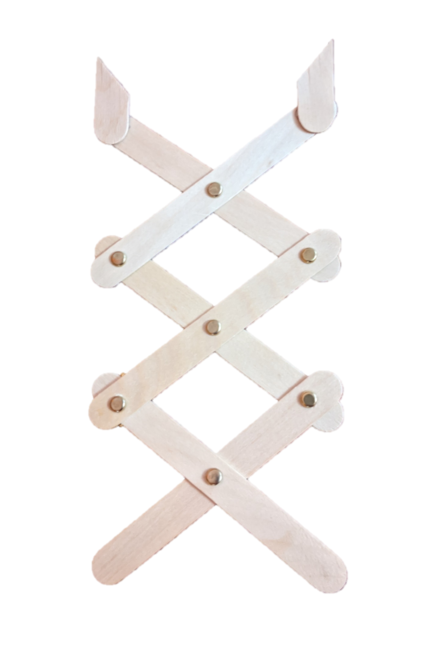
Science Action
The Grabber Arm Lab
Notes:
Here’s what we’re going to make

Slide 2
Notes:
This is what it can do

Slide 3
Notes:
Optional Slide: There’s been a spill of hazardous waste at a nearby manufacturing plant. You are tasked with picking out small machine parts from the spill to be cleaned and reused – but you must not touch the hazardous waste! Assemble your grabber arm devices and get to work!

Slide 4
Each Kit Includes:
2 Sticks with Glued Pieces
4 Sticks
7 Fasteners
Notes:
Each kit should come with

Slide 5
How to Assemble: Step 1
Make 3 X’s
Note: It helps to have sticks going the same direction

Slide 6
How to Assemble: Step 2
Insert a fastener through each center

Slide 7
How to Assemble: Step 2
Turn X over. Be sure to push the fastener prongs down to secure

Slide 8
How to Assemble: Step 3
Line up the X’s and connect with fasteners
1
2
3
4

Slide 9
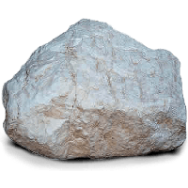
Test It Out
Try grabbing different objects

Slide 10
Next Level: How to Improve
How could you improve it to…. (pick one)
Soak up liquids
Pick up tiny sprinkles or confetti
Grab something heavy
Grab something round
Make it work with only one hand
Reach farther
Other Idea:___________________
What materials might you use? (e.g. wood, metal, sponges, plastic, tape) Why?

Slide 11
Next Level: How to Improve
Choose one idea. Write what you’d do and why. Draw a picture to illustrate.

Slide 12
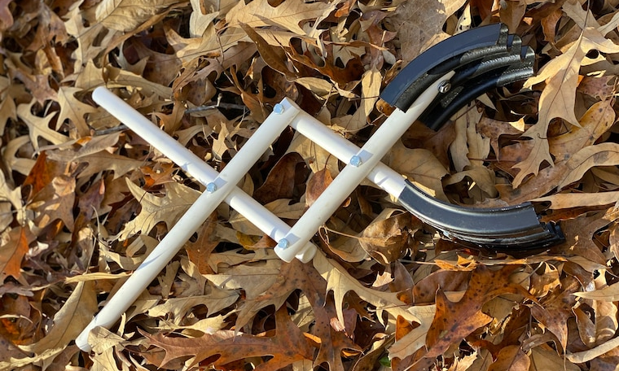
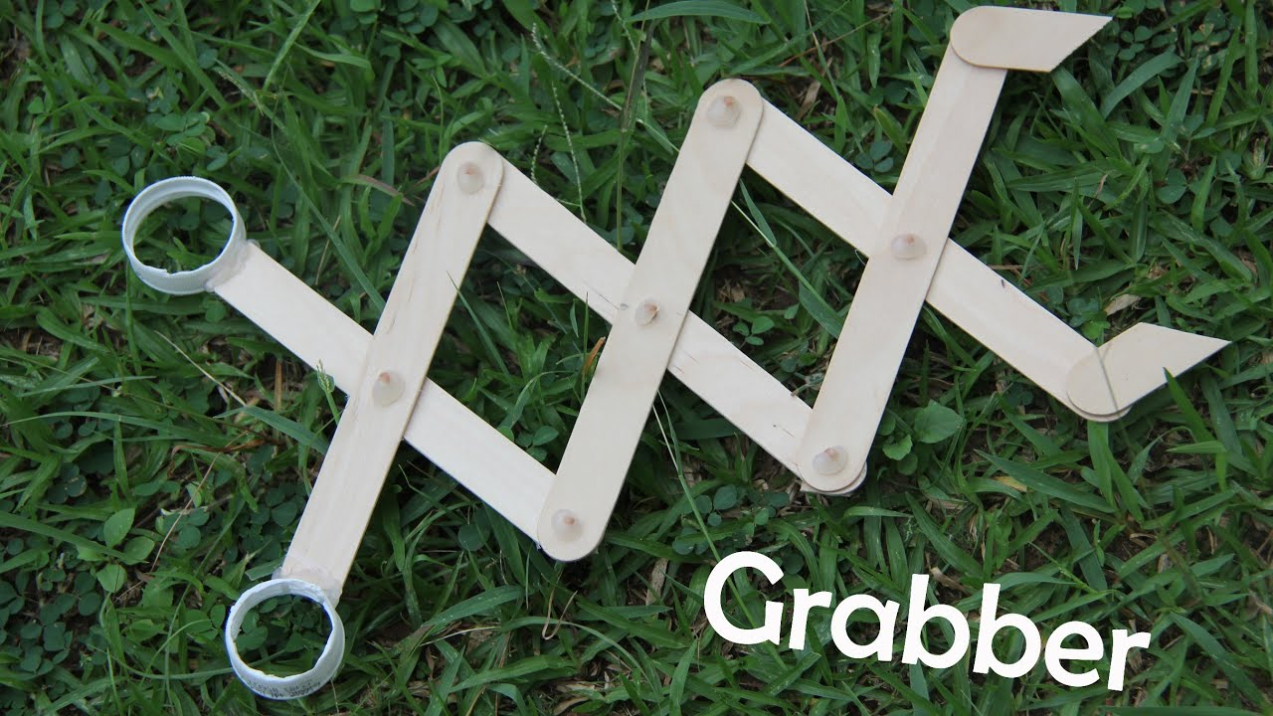
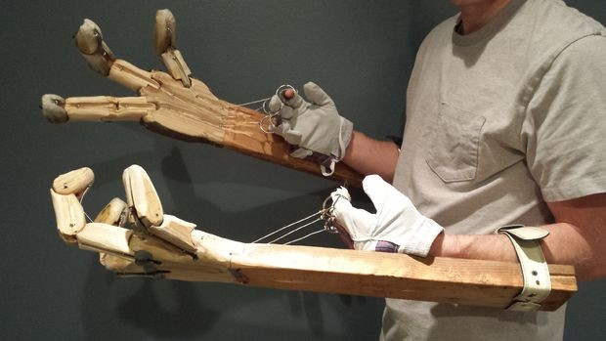
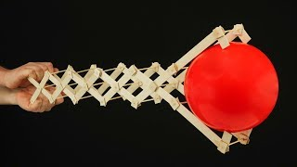
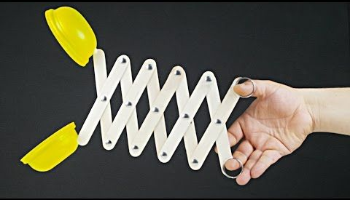
Notes:
Google: DIY Extender Arms (or Grabber Arms) for other ideas/see what’s been done

